Slide 1
Sensa Band

Slide 2
PROBLEM STATEMENT
"Women and children are often vulnerable in isolated public spaces, where danger can appear without warning. Current safety tools are reactive and require manual activation, offering no way to proactively detect threats such as hostile behavior or concealed weapons. This leaves them without an early-warning system that could prevent harm."

Slide 3
INTRODUCTION
Women and children are most vulnerable in isolated public spaces, where threats often appear without warning. In situations like waiting alone at a bus stop, potential attackers may approach undetected until it is too late to react. Existing safety solutions—such as mobile SOS apps, panic buttons, or self-defense tools—are reactive, require manual activation, and cannot proactively assess danger. There is currently no intelligent, wearable device that can scan approaching individuals for hostile intent, threatening behavior, or concealed weapons, and instantly alert both the wearer and emergency responders before an attack occurs. This critical gap leaves countless women and children without a reliable early-warning system that could save lives.

Slide 4
Root cause analysis
Problem:
Women & children face sudden threats in isolated public spaces
↓ Why?
Attackers can approach unnoticed until it’s too late
↓ Why?
No system exists to proactively scan and identify threats
↓ Why?
Current safety devices are reactive & need manual activation
↓ Why?
They lack AI to monitor speech, facial expressions, weapons in real time
↓ Why?
Wearables focus on health tracking, not compact safety AI solutions
ROOT CAUSE:
Absence of compact, AI-powered proactive threat detection
→ Critical delay between danger detection and response

Slide 5
Sensa Band – Prototype Concept

Slide 6
Hardware Components
Form Factor: Sleek wristband, lightweight, waterproof, and durable.
Core Sensors:
Microphone Array – for speech tone analysis & keyword detection.
Mini Camera / IR Sensor – for facial expression & behavior recognition.
mmWave / Thermal Sensor – for detecting concealed metallic weapons.
Accelerometer + Gyroscope – for movement & struggle detection.
Heart Rate Sensor – to monitor sudden spikes in the wearer’s stress levels.
Alert System:
Tri-color LED – Green (safe), Yellow (caution), Red (danger).
Vibration motor – discreet danger alerts.
Connectivity:
Bluetooth Low Energy (BLE) – to connect with smartphone app.
4G/LTE or LoRa (optional) – for direct police alert without phone dependency.
Battery:
Rechargeable lithium-polymer battery (5–7 days standby).

Slide 7
Software & AI
On-Device AI Models:
Speech emotion recognition (threat, aggression, distress).
Facial micro-expression analysis.
Suspicious movement detection.
Weapon detection using thermal/mmWave patterns.
Cloud Processing:
For advanced analysis & pattern updates.
Mobile App Dashboard:
Live status indicator.
Emergency contact setup.
Location tracking & history logs.
SOS Automation:
On danger detection → Sends GPS location & alert to:
2 emergency contacts.
Nearby police control room.

Slide 8
Operation Flow
Idle Mode: Constant passive scanning of surroundings within ~3–5 meters.
Detection Mode: If strangers approach → speech & movement analysis.
Threat Confirmation: If aggressive speech, hostile facial cues, or weapon is detected → LED turns red + vibration alert.
Emergency Mode: Sends SOS with location to pre-set contacts + police.
Post-Event Log: Incident stored for later review.

Slide 9
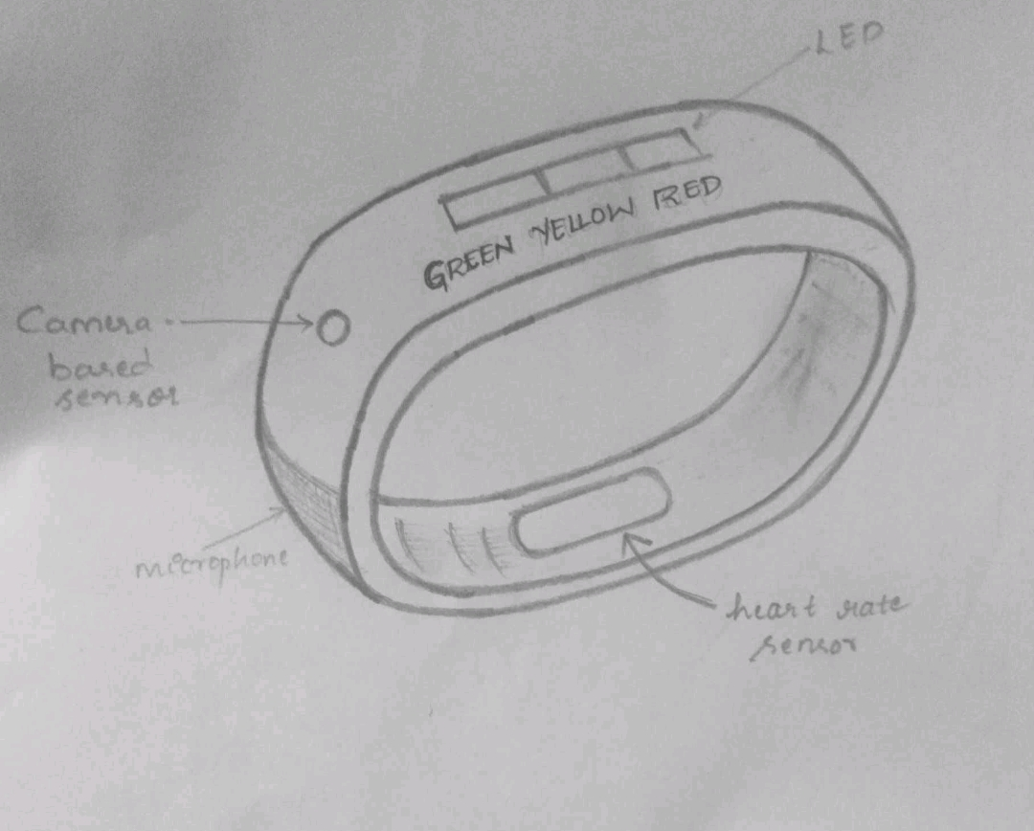
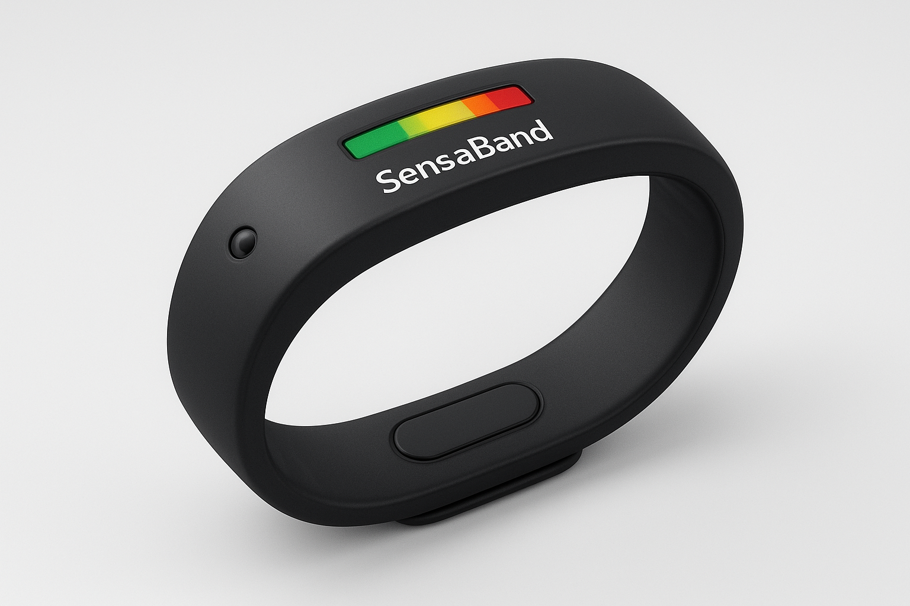
PROTOTYPE

Slide 10
THANK
YOU

